Slide 1
Interpretation of HF channel parameters based on waterfall spectrograms
W. N. Furman, J.W. Nieto, W.M. Batts
HFIA Meeting 09/24/2015

Slide 2
Overview
Example waterfall spectrogram
A surprise(?)
Experimental block diagram
Key building blocks
Possible solution(?)
Moving forward
Another example waterfall spectrogram

Slide 3
Example waterfall spectrogram
Click to view video
April 7,2015, 16km link, H Doublet & Inverted V antenna, ~100 Watts, MIL-STD-188-110C-D, Harris WMT/STANAG5066

Slide 4
A Surprise (?)
16 km link
Expected nice ground wave link
Fading and multipath, as evidenced by nulls in the spectrogram confirmed that we had sky wave propagation components
Important fact
Multipath introduces frequency selective nulls that are spaced 1/T apart, where T is the multipath spread in seconds
Frequency offset on a path will slide the null across the signal spectrum
Question
Could we use the HF Channel Simulator to introduce channel degradations to replicate the captured waterfall spectrogram?
Could this approach be used as a tool to understand propagation related channel effects?

Slide 5
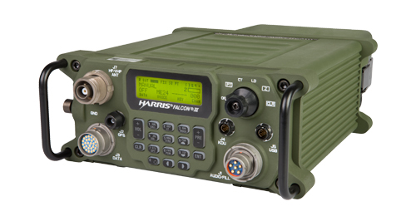
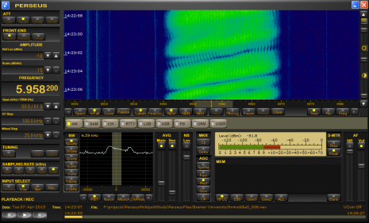
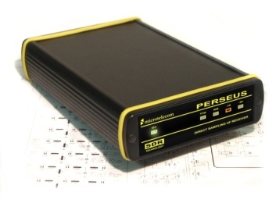
Experimental Block Diagram
Parameters
I/Q WAV File @ 96ksps
HF Channel Simulator
I/Q WAV File @ 96ksps
Sample rate
Converter
24 KHz WB HF
I/Q WAV File @ 2Msps
Perseus File Header
HF Channel simulator parameters are adjusted so that the waterfall spectrogram is similar to those collected on-air

Slide 6
Key Building Blocks
1 path, (0dB, 0ms, 0Hz, 0 Hz)
2 path, (0dB, 0ms, 0Hz, 0 Hz) (0dB, 0.2ms, 0Hz, 0 Hz)
2 path, (0dB, 0ms, 0Hz, 0 Hz) (0dB, 2ms, 0Hz, 0 Hz)
2 path, (0dB, 0ms, 0Hz, 0 Hz) (0dB, 0.1ms, 0Hz, 0 Hz)
Path Definition: Gain(dB), delay(ms), Doppler Spread(Hz), Frequency Offset(Hz)

Slide 7
Key Building Blocks
2 path, (0dB, 0ms, 0Hz, 0 Hz) (0dB, 0.2ms, 0Hz, 1 Hz)
2 path, (0dB, 0ms, 0Hz, 0 Hz) (0dB, 0.2ms, 0Hz, -1 Hz)
2 path, (0dB, 0ms, 0Hz, 0 Hz) (0dB, 0.2ms, 0Hz, 0.1 Hz)
2 path, (0dB, 0ms, 0Hz, 0 Hz) (0dB, 0.2ms, 0Hz, 0.2 Hz)

Slide 8
A Possible Solution
Click to view video
3 path, (-20dB, 0ms, 0Hz, 0 Hz) (0dB, 2ms, 0.2Hz, -0.2 Hz) (0dB, 2.1ms, 0.3Hz, 0 Hz)

Slide 9
A Possible Solution #2
Click to view video
3 path, (-5dB, 0ms, 0Hz, 0 Hz) (0dB, 2ms, 0.2Hz, -0.2 Hz) (0dB, 2.1ms, 0.3Hz, 0.4 Hz)

Slide 10
Moving Forward
Collect more waterfall spectrograms on various links
NVIS ( < 200 km)
Long haul (2000-4000 km) links
Simultaneously collect received waveform samples
Process received samples by Wideband HF data modem
Contrast and compare modem estimated channel parameters with graphically derived channel parameters
Possibly enhance channel simulator to vary path delays as well as frequency offset, Doppler spread and Gain.
Hope to report on results at Nordic HF16

Slide 11
Another Example
A video example from recent Stockbridge ( 160 km NVIS) run
Click to view video

